Slide 1
Frank Randell
Founder Member of Thanet Road Club
He was just 19 when the club was started
Interviewed by Jack Hill and Flynn Robinson on 17th January 2016 for The Young Biographers’ Project

Slide 2
Frank

Slide 3
Club Champion and Club Legend
Headlines of the day
“Randell’s still on form”
“Randell’s runaway victory”
“Randell smashes course record”
“Team did well in Essex”
Between the ages of 21 and 25 Frank was club champion for 4 years and he raced from 1948-1958.

Slide 4
The Good Ol’ Days
Cycling made you tough. There was no lycra, clothing was wool which wasn’t very pleasant when it got wet. There was no cold weather clothing – your feet used to freeze as you didn’t have overshoes. Clothing was generally black and you wore jeans or shorts.
On the Sunday run you would do 100 miles and you would freeze because you wore big heavy sweaters.
Sounds like fun!!

Slide 5
Earliest TRC memory
Frank’s first race started at Margate Clock Tower and went to Herne Bay – approximately 25 miles and he did it in 1 hour 17minutes. They didn’t have computers in those days.
Frank thinks that cycling was at its best in his early days as there wasn’t the traffic on the road.
He has lots of good memories of the club and one of the best is that they all talked about bikes. He has a couple of bad memories too like the time he was doing Hollingbourne Hill climb and ended up under a car. Luckily the car was going slowly and he didn’t go under the wheels.

Slide 6
Standing around at the side of the track dressed in warm clothes. Some things don’t change – just like Betteshanger now!

Slide 7
Racing and Riding
Frank had to ride to the start of races so this meant leaving at 6am so he had to get up at 5am. An early start!
Sometimes he got the train to the start of a race as he wanted to save his legs, but then after the race he would ride home because he could only afford to get the train one way.
During the war Frank lived in Wolverhampton and his first ride was 110 miles long. Once he even rode from his home in St Peters to Wolverhampton, stayed the night and cycled back the next day.
Frank was so dedicated to his cycling that he would even ride on Christmas Day.

Slide 8
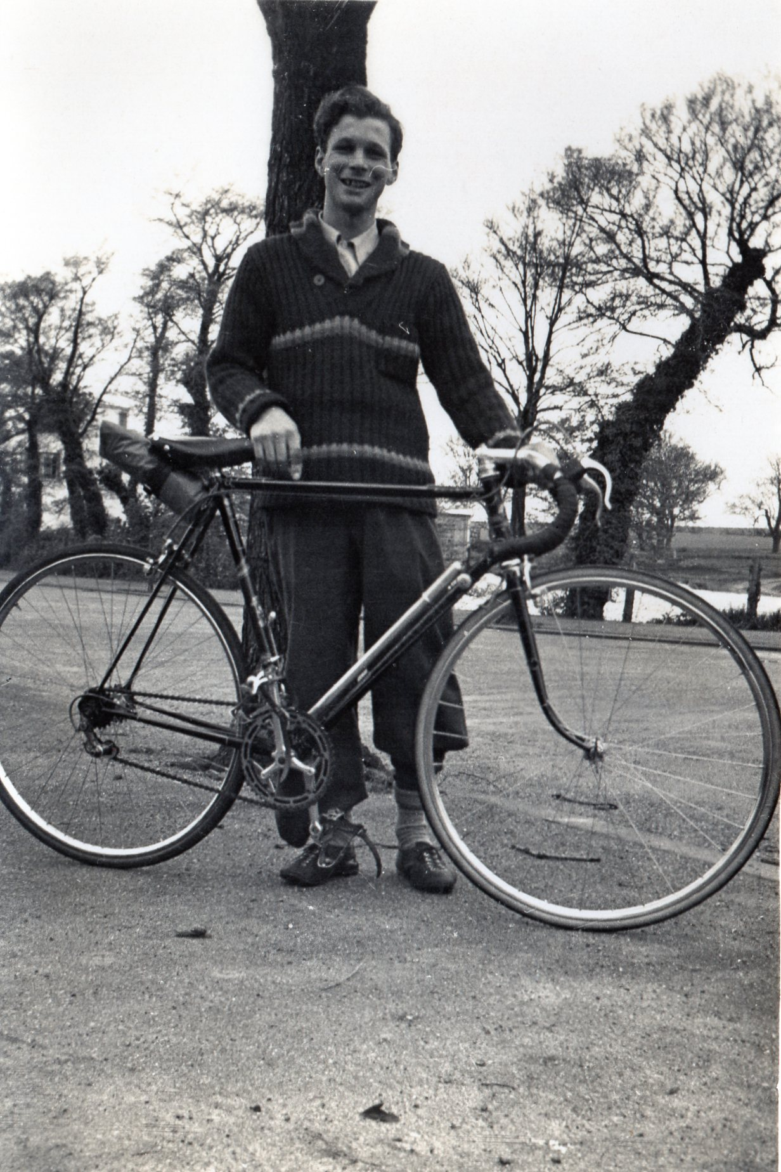
Imagine riding that bike now – no carbon in sight

Slide 9
How many bikes did/do you have?
His first bike was a Viking.
His first lightweight bike was a Holdsworth. It was red steel with 5 3 1 tubing. He hit a milk van on it in a race and bent the forks. That was the end of that one !!
He also had a welded Claud Butler. It was too light and Frank kept bouncing off the road – Frank is very light himself and he felt he couldn’t control it!
He also had a Thanet bike. Yellow with chrome. He bought it because he was a member of Thanet.
Frank rode fixed wheel bikes with no gears. He raced on 81.
Frank has still got 2 racing bikes and 3 electric bikes.

Slide 10
The low riding style, sometimes so low Frank would smash his forehead on the extension. Not a bike helmet in sight!

Slide 11
Just a few of Frank’s medals

Slide 12
Frank still holds the following Place to Place Records (there and back)
Ramsgate Canterbury 1:19:50 September 1949
Ramsgate Deal 58:04 June 1950
Ramsgate Dover 1:35:12 August 1952

Slide 13
Once a TRC member, always a TRC member

