Slide 1

Young Biographers’ Project – Terry Fearn
By David Redmond

Slide 2
Who is Terry Fearn?
A club veteran and member for many years
Born – 6th February 1948
Joined Thanet R.C. around 1987
Was secretary of the club for over 20 years, helping the club grow from strength to strength
Has won the Dave Saffery award for service to the club

Slide 3
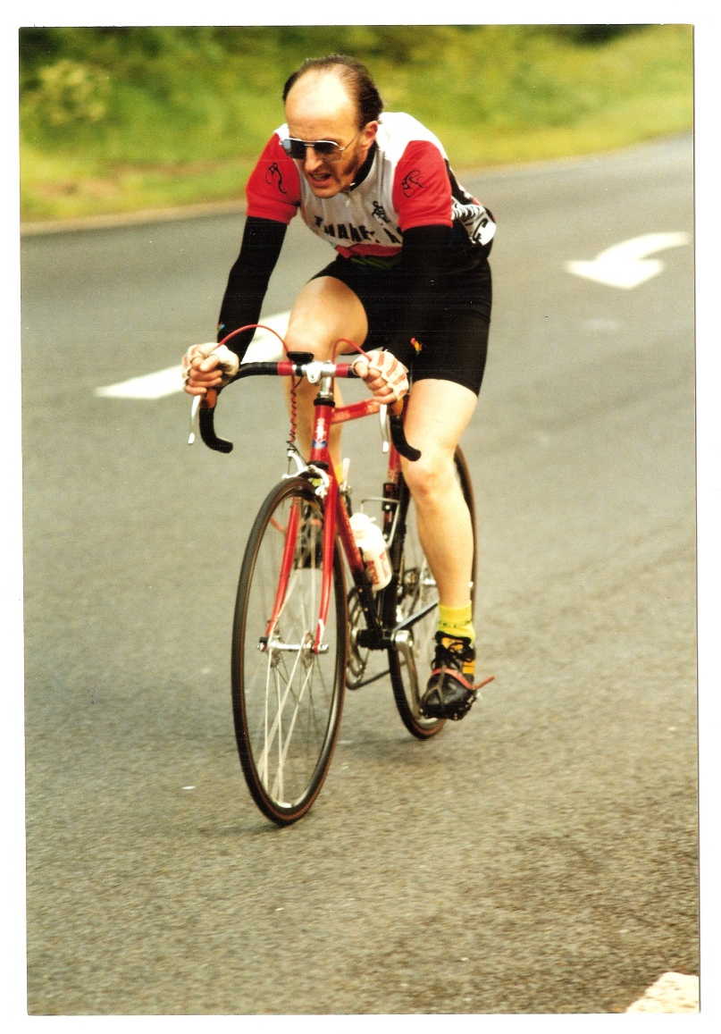
1994 Harrietsham 25 Mile TT
Terry Fearn

Slide 4
Secretary Role
Terry was secretary of the club from around 1989 – 2011
Apart from the usual jobs of correspondence, affiliations, membership, and AGM/committee meeting agendas and minutes, Terry also attended the KCA & RTTC (now CTT) annual meetings
Also as secretary, he attended the meetings to discuss the setting up of the Fowlmead (now Betteshanger) track and other cycling facilities there as well as being involved in the early Go-Ride set up!

Slide 5
Secretary role ContinueD
During the time Terry was secretary he was also, for several years, chairman, and with Dave Saffery’s help organised the club’s 60th anniversary ride
While Terry was secretary the membership fluctuated from a high of over 150 to a low of about 30; it rose and fell several times over the years

Slide 6
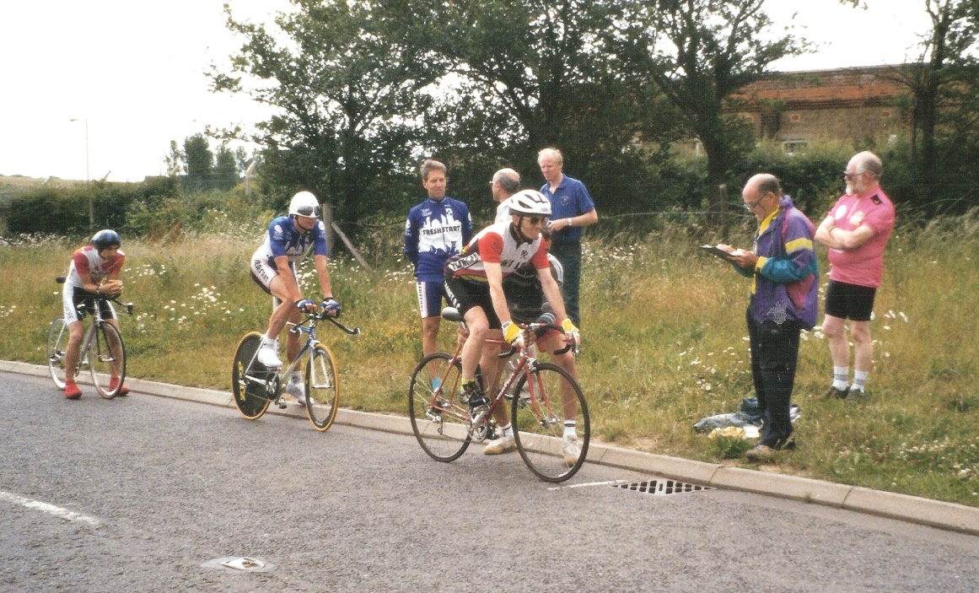
1997-Sean Yates behind Terry on one of his attempts to break the British 10 mile TT record
Len Coomber
Dave Saffery
Sean Yates!!!
Terry Fearn

Slide 7
Favourite parts of being with Thanet R.C.
Terry said that by joining Thanet R.C. he has made many great friends over the years
His favourite part of being with Thanet R.C. is the social rides, being able to turn up and ride many miles in good weather conditions and enjoy the countryside and the sport as a way of having fun

Slide 8
Favourite parts ContinueD
One of his first memories are the club runs and enjoying riding 50-60 miles at 15mph average speed
Also, when punctures were more common many years ago, having a large saddle bag that had many useful things in!!!

Slide 9
Thanks to the following
Music (when presented) – Tour de France Retro Channel 4 Theme Music Remix (whole version made by YouTube user Constance Bour)
Photography – Terry Fearn and David Robert
National Lottery Heritage Fund, Imogen Taylor (Young Biographer Workshop Facilitator), Terry Fearn (for being my Veteran rider) and also the club for its support

Slide 10
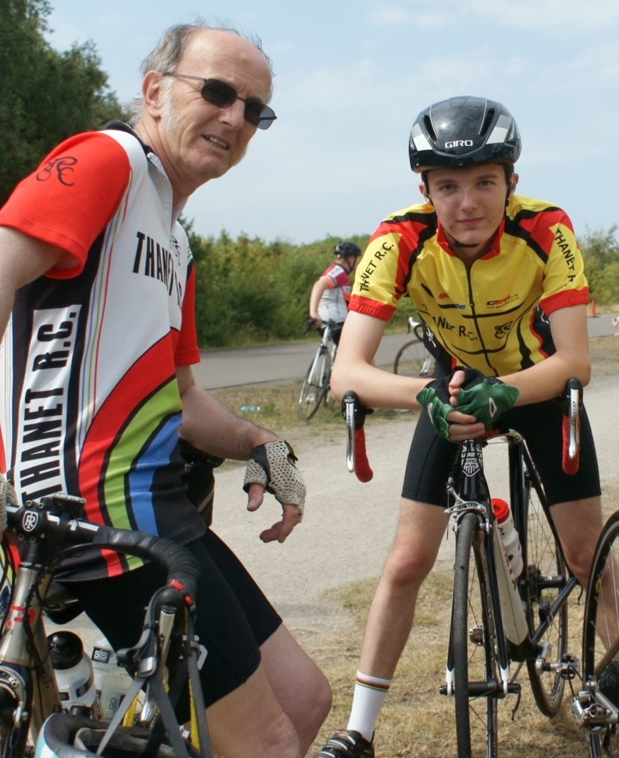
THE END

