Slide 1
What is Go-Ride?
Go-Ride is British Cycling's development programme for young people.
The programme provides a fun and safe way to introduce young riders to the world of cycle sport and provides a platform to improve bike handling skills.
Go-Ride provides the first step onto the Performance Pathway - over 60% of riders on the Great Britain Cycling Team started out at Go-Ride Clubs.

Slide 2
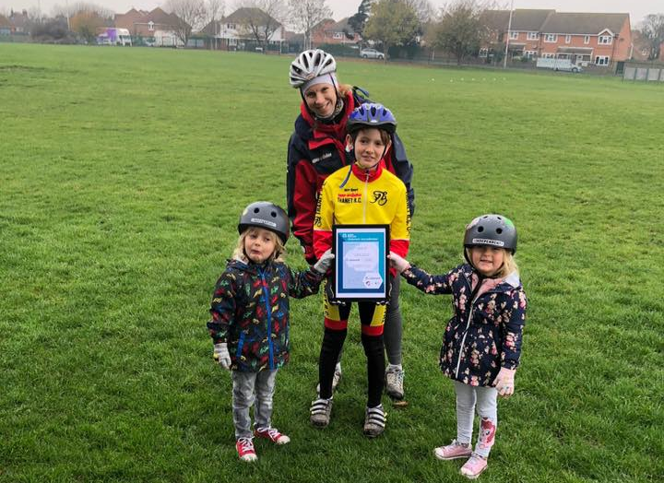
In November 2018 we were awarded our Clubmark renewal:
2018 Renewal 3 year Development Targets:
Aim 1: Establish suitable Go-Ride venues accessible to existing and new members.
Aim 2: Recruit and retain more coaches
Equity Aim: More older (14+) girls in the club

Slide 3
Venues
Draper’s Mills Primary
Venue trialled Nov-Dec 2018
Excellent venue but costs not covered due to low numbers
Discovery Park, Sandwich
Free Go-Ride Venue
Tarmac Oval bus turning circle, approx. 200m long.
Perfect for U12 coaching and racing.
Moving forward:
Venue needed for older youth/junior/adult coaching
Lots of people have enquired re adult coaching sessions

Slide 4
Go – Ride 2019
Over 20 riders aged 18 months to 12 years old have joined us for coaching and/or racing
One Go-Ride racing event at Discovery Park
Over 20 Go-Ride Coaching Sessions
Colin’s Summer series events well attended

Slide 5
Go – Ride 2019
Big thanks to everyone who has volunteered at Go-Ride events over the year!

Slide 6
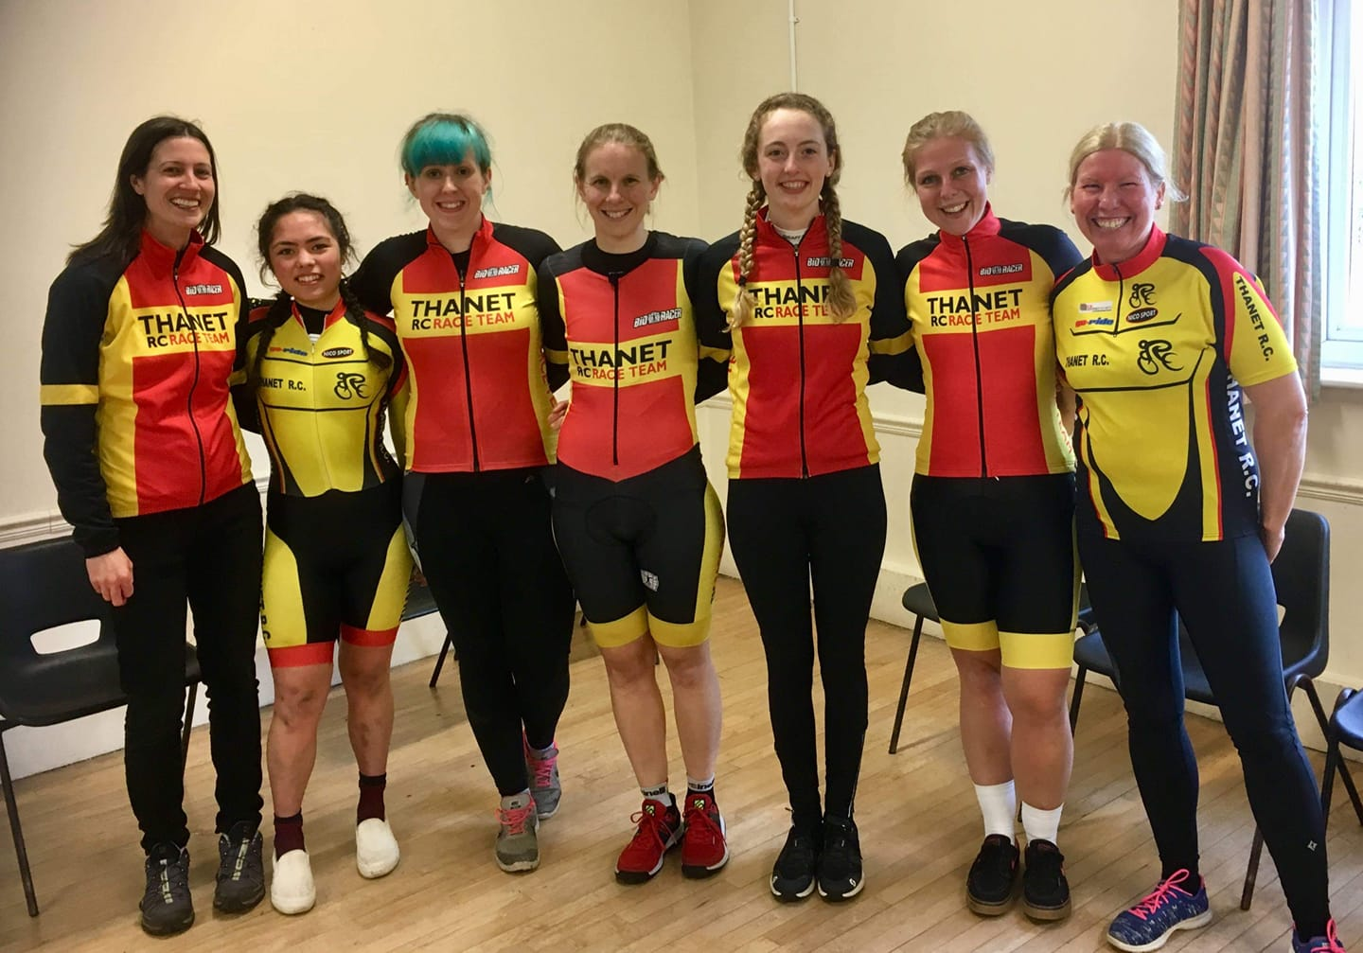
TRC Women
Positives this year:
more women riding the club run
more women riding TTs in club kit
7 TRC women at one Open TT!
TRC women’s teams racing at national level TTT events
Success at:
Time Trials
Team Time-trials
Criteriums
Road Races
Track
Fixed Crits

