Slide 1
 | 2013 | 2014 | 2015 | 2016 | 2017 | 2018 | 2019
Website Updates | 8? | 220 | 228 | 215 | 167 | 149 | 83
Facebook Fan Page | 0 | 334 | 485 | 599 | 695 | 736 | 781
Facebook Group |  | ?? | 510 | 610 | 743 | 746 | 761
Twitter Followers | 0 | 167 | 284 | 416 | 536 | 572 | 588
News Feed Followers | 0 | 189 | 315 | 463 | 585 | 628 | 643

Slide 2
Issue
Lack of content / article

Slide 3
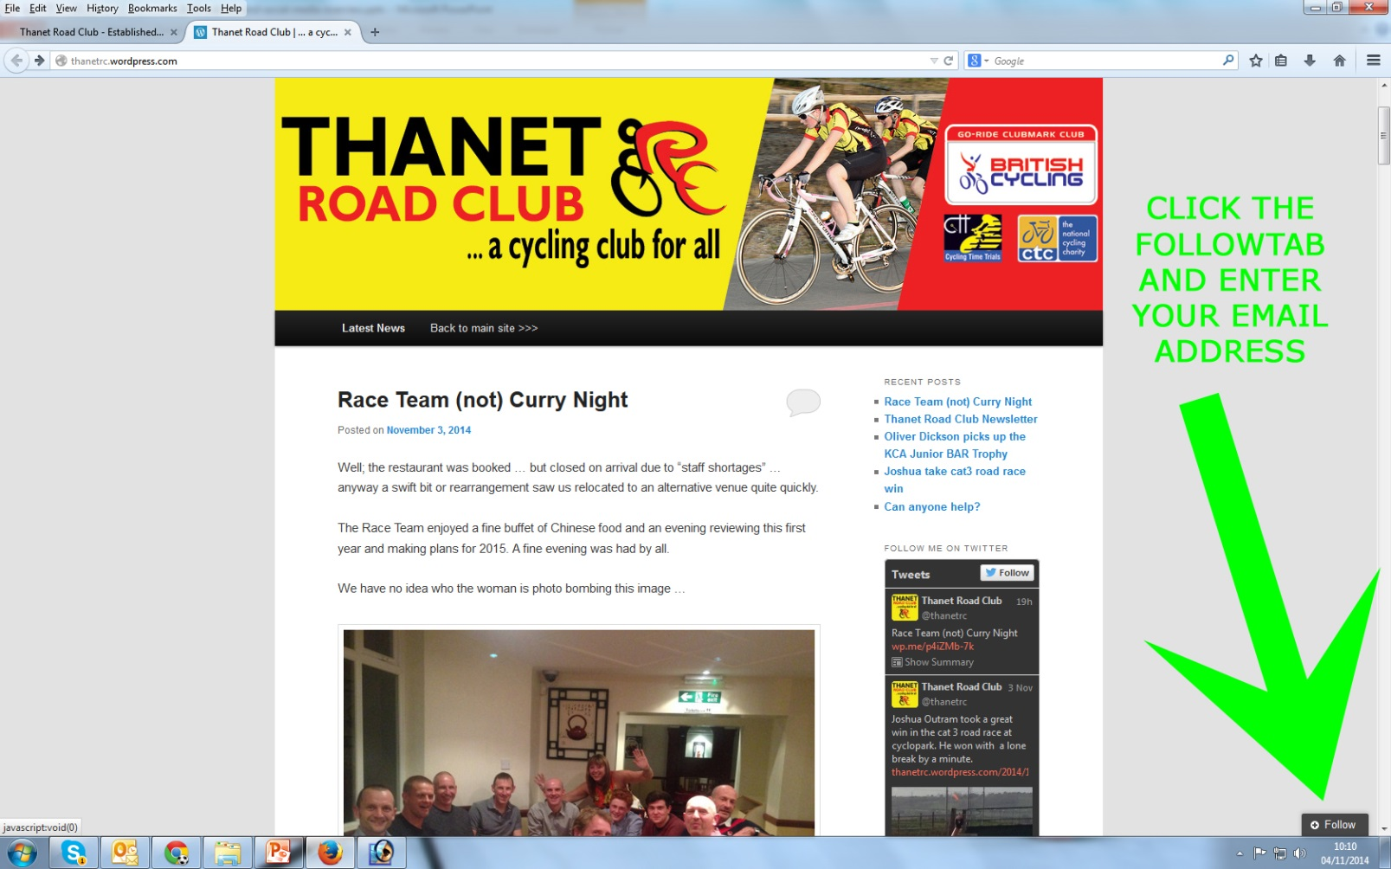
Sign Up to the Newsfeed … Select “Latest News” then click “Follow”

Slide 4
Questions?

