Slide 1
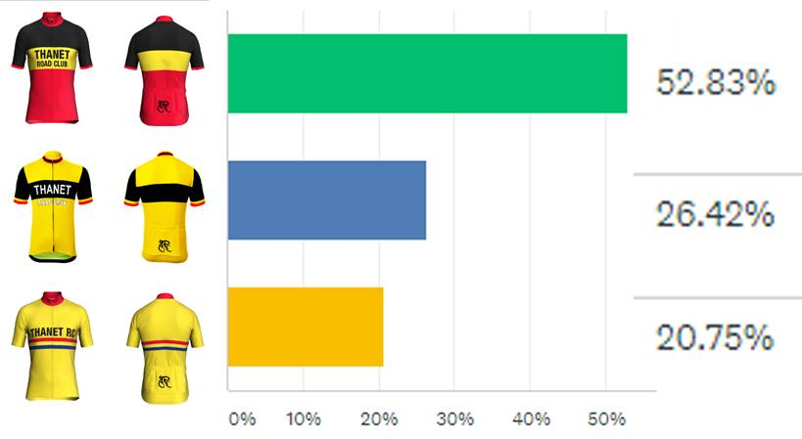
AGM 2018 we voted to explore the option
12 designs submitted from the membership
Short list of 3 were voted on by the members

Slide 2
The proposed new design has been approved by British Cycling
Now we need to hold a member vote:
Adopt the new design or stay with the existing?

