Slide 1
TRC TT Secretary Report
November 2018

Slide 2
2018 Season Summary
TRC Evening Time Trial Highlights
25 events - 867 participant rides
38(44) Average per event, 196(138) Junior, 671(714) Senior
17 x 10TTs at BCP
3 x 25TTs at BCP
2up, 4up and 1hr events
Open Events
Approximately 42(42) events ridden by TRC members, 317(352) rides in total
2up TTT 67 riders (25 TRC)
25TT (TW) 57 riders (24 TRC)
10TT (BCP) 57 riders (22TRC)
10TT (TW) 74 riders (27 TRC)
Hill Climb 20 riders (15 TRC)

Slide 3
2018 TRC Evening Event Summary
867 total rides (2017 – 887, 2016 – 1059)
2 cancelled/rescheduled events (5 cancelled in 2017)

Slide 4
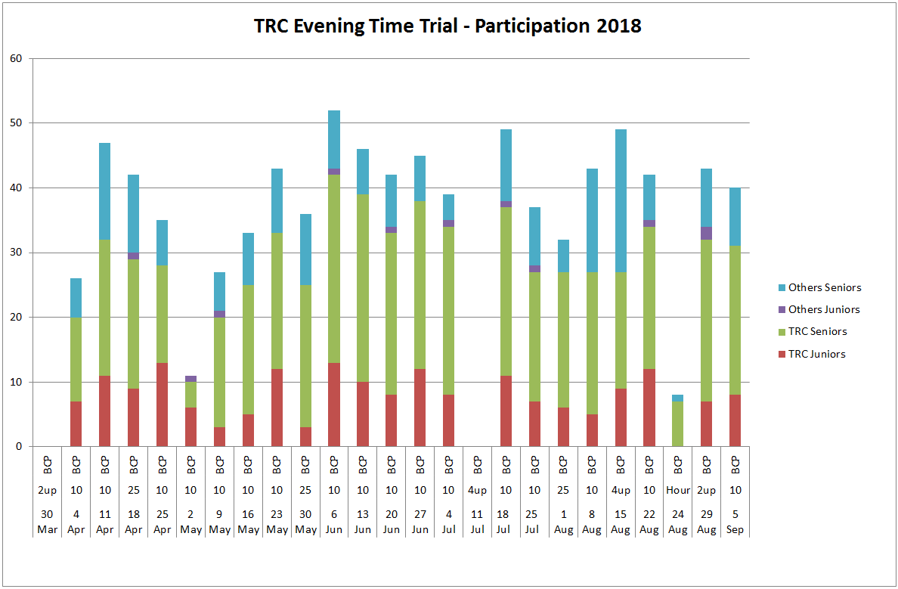

Slide 5
2019 Timetable
Schedule similar to 2018
Evening 10TT’s
All events at BCP
2Up
3Up (new event)
4Up
3 x 25TT’s
1 hour
Hill Climb at St Margaret’s
See the TRC website to download

Slide 6
2019 Open Events
Easter Monday 22nd April - 2up TTT (08:30)
Saturday 8th June – TRC 10TT Q10/31 (06:00)
Sunday 23rd June – TRC 25TT Q25/10 (06:30)
Sunday 1st September TRC 10TT Q10/30 (07:00)
Hill Climb 13th October – St Margaret’s

