Slide 1


Slide 2
What is Go-Ride?
Go-Ride is British Cycling's development programme for young people.
The programme provides a fun and safe way to introduce young riders to the world of cycle sport and provides a platform to improve bike handling skills.
Go-Ride provides the first step onto the Performance Pathway - over 60% of riders on the Great Britain Cycling Team started out at Go-Ride Clubs.

Slide 3

2018 Renewal Development Targets:
Aim 1: Establish suitable Go-Ride venues accessible to existing and new members.
Aim 2: Recruit and retain more coaches
Equity Aim: More older (14+) girls in the club

Slide 4
Why the new venue?
Not possible to book Betteshanger at the weekend
No safe, flat area for Go-Ride bike handling skills coaching
No opportunities to complete the British Cycling performance pathway benchmark activities
Currently we are trialling the venue – we are running sessions every Saturday until the end of this school term.

Slide 6
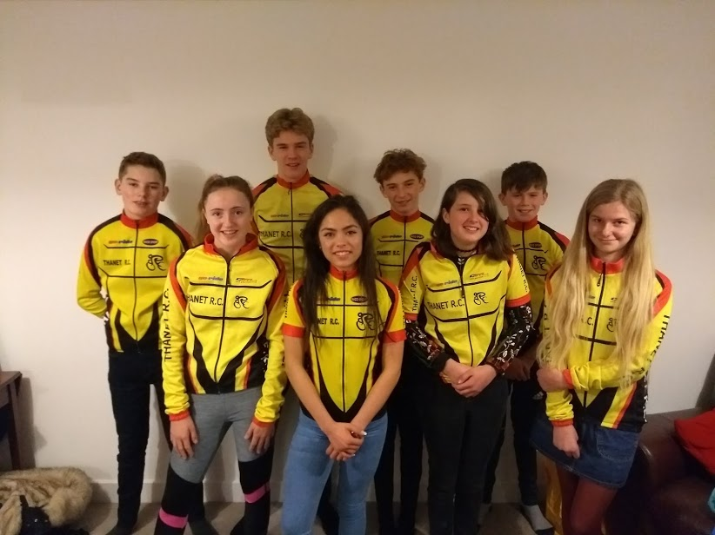
Thanet RC Youth Academy 2018

Slide 7
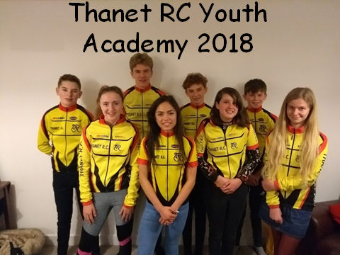

Massive thanks to for their generous funding of the TRC Academy in 2018.
Academy Riders have raced:
Track League,
National Omnium,
Open Time Trials
Cyclocross
Belgian Kermesses
Stage Races (UK + Abroad)
National Youth Series
Regional Championships
GHS National Championships
Attended RSRs and Cluster sessions
With podium placings in
Regional Championships
Lots of local Crits
Timetrials
Cyclocross
Wins at:
Cyclocross
Time trials
Criteriums
11th Place in a Belgian Kermesse!
Club Time Trial records!
Some incredible breakaways, teamwork and gutsy riding!

Slide 8
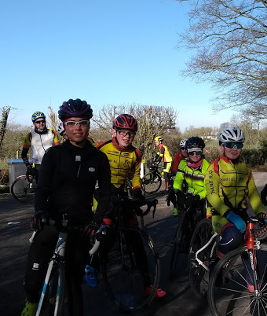
Thanet RC Academy 2019
Education
Preparation
Team work
FUN!
For:
Riders in Youth A and the second year of Youth B (born 2003/4/5) planning to race and/or volunteer in 2019.
What is involved:
Coaching
  Rollers/turbo starting on 9th January
  Evening summer sessions TBC
Club Riding Opportunities
  Weekly club run year round
  Evening Time Trials
Education

Slide 10
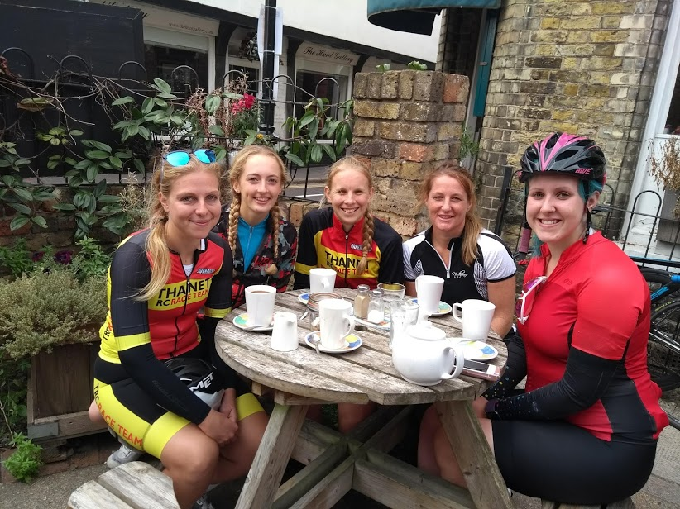
Women’s Rep Report
Participation in:
Reliability Rides
Breeze Rides
Club Runs
Audax
Track Sessions
Racing in:
Road
Track
Time Trials
Cyclocross
Contact with the youth girls

Slide 11
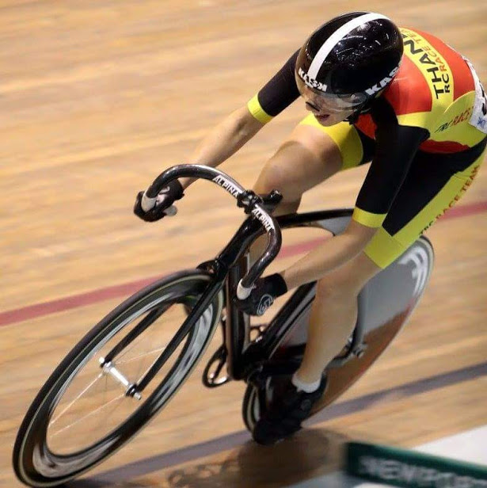
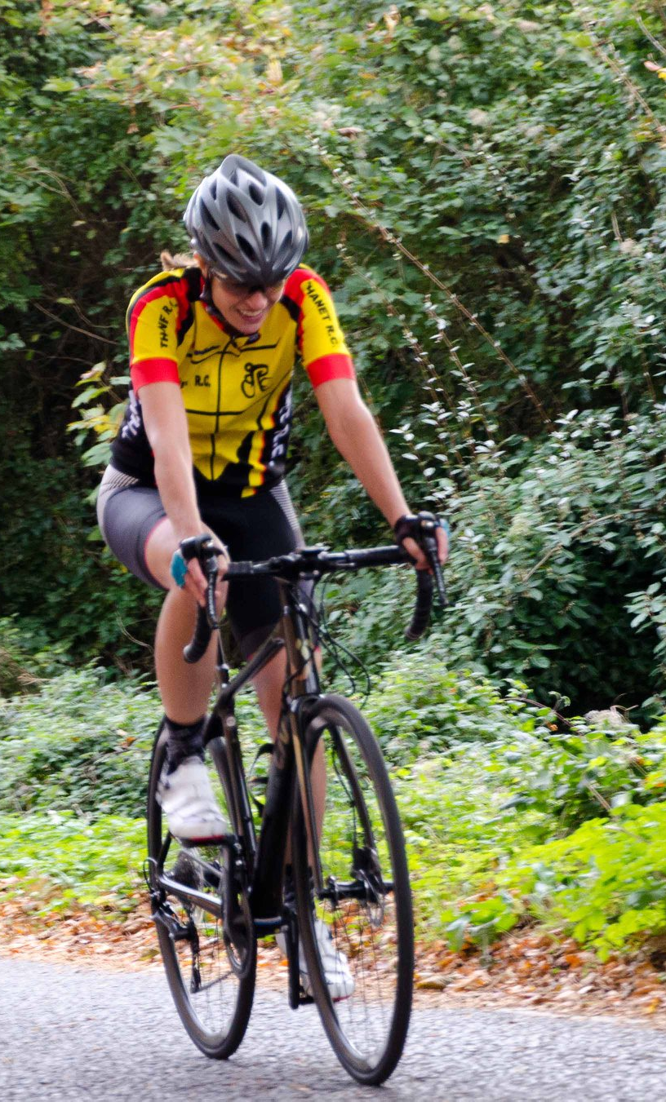
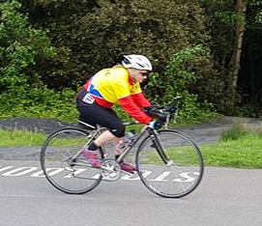

Slide 12
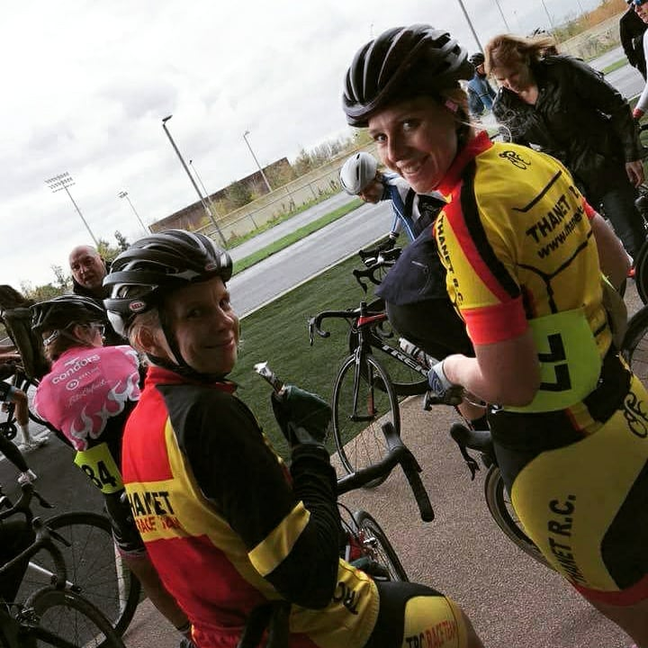
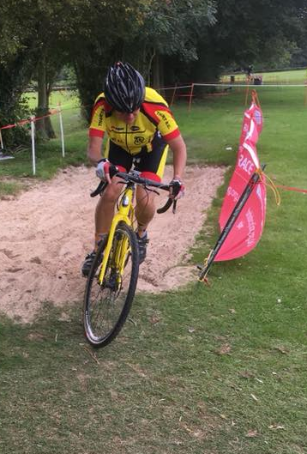
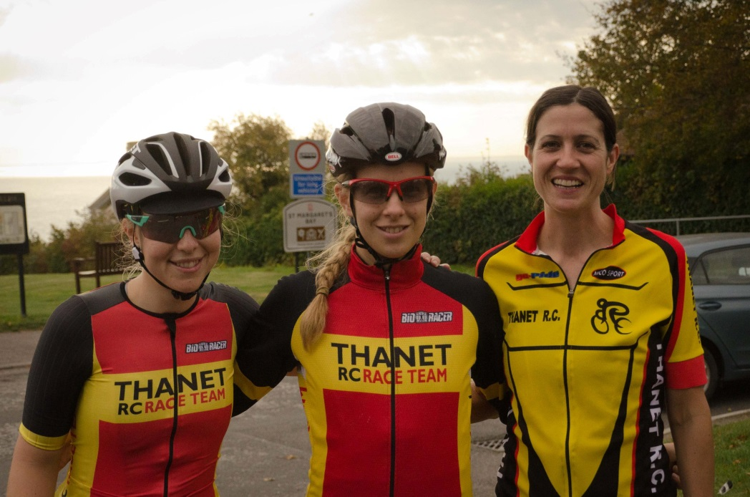

Slide 13
