Slide 1
Thanet Road Club Race Team
2017

Slide 2
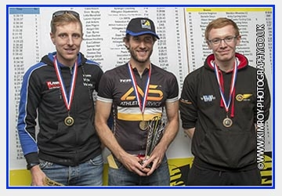
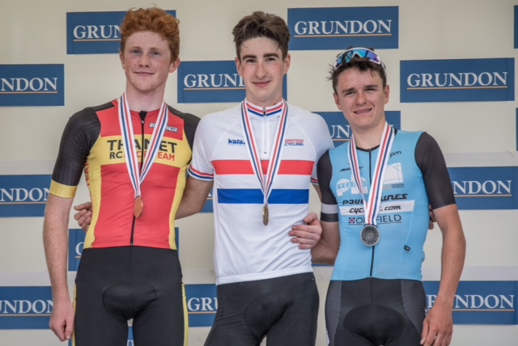
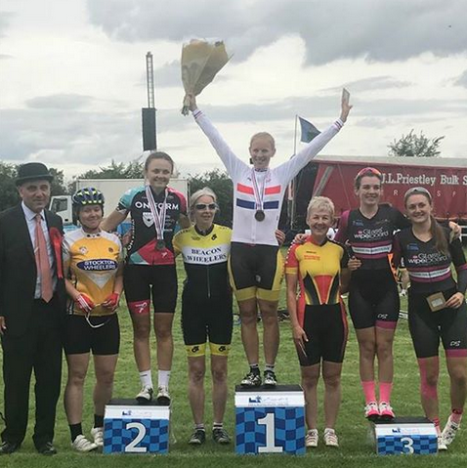
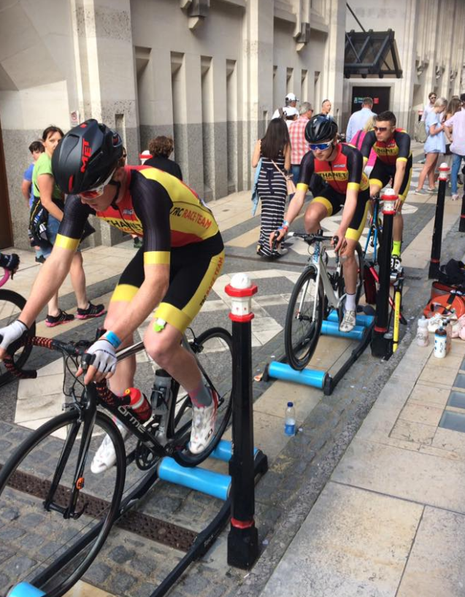
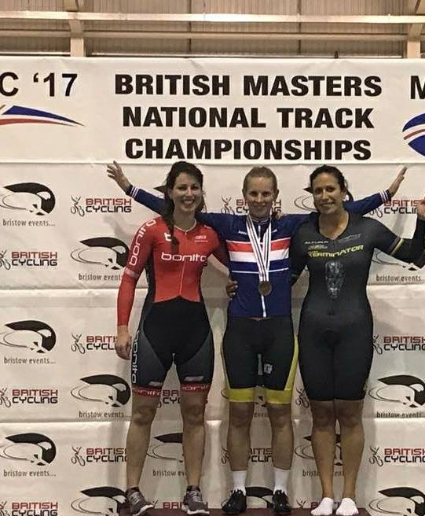
15 Road Wins
21 Open Time Trail Wins
22 Track Wins
4 National Titles
10 National Podiums
352 Open TT Rides

Slide 3
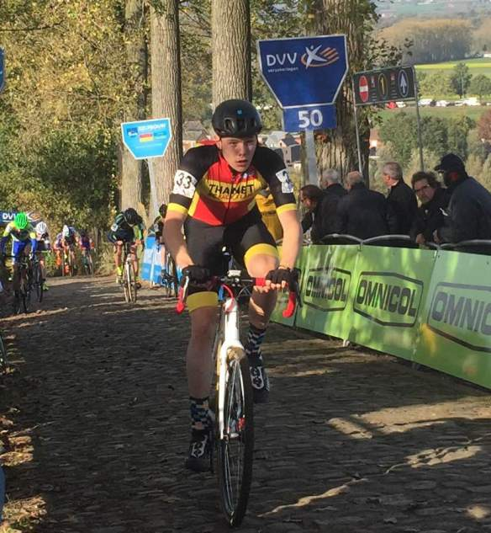
Notes:
Membership has increased as have junior member - evidence that the race team is working
Focus for 2018...! We need to focus on increasing our women membership...

Slide 4
Questions?

