Slide 1
Heritage and Sponsorship Report
… and a bit of funding
David Robert

Slide 2

Heritage
Cycling for Generations film on YouTube. 1700 views
Featured in Ramsgate International Film and TV Festival 2017
Exhibition of our archives at The Archive Gallery, Ramsgate
Archive photos of many veteran members on Flickr
Young Biographers Project: 9 participants producing a photo series, a multimedia work, 2 films, 2 presentations, oil paintings and a collage
Members’ pin badge, year book, frame sticker
Tuesday Socials
Limited edition club jersey and hoodie

Slide 4
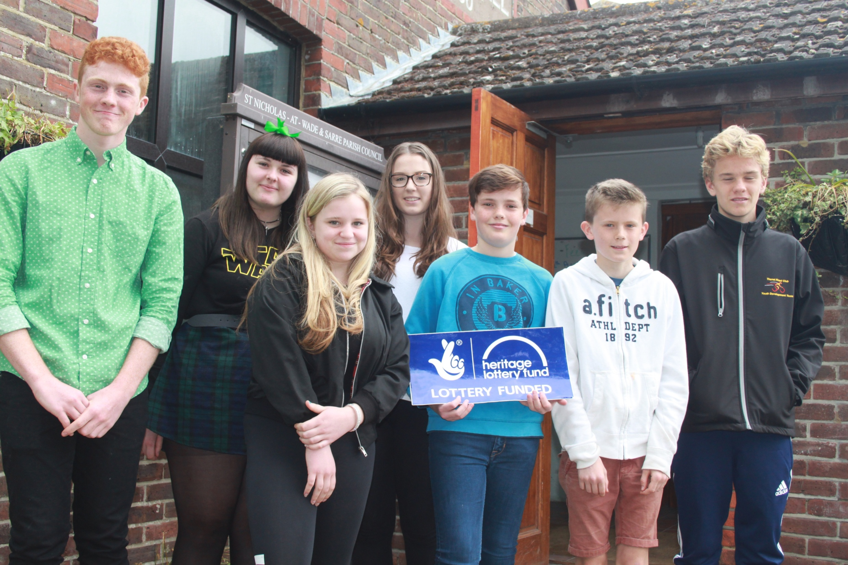

Slide 5
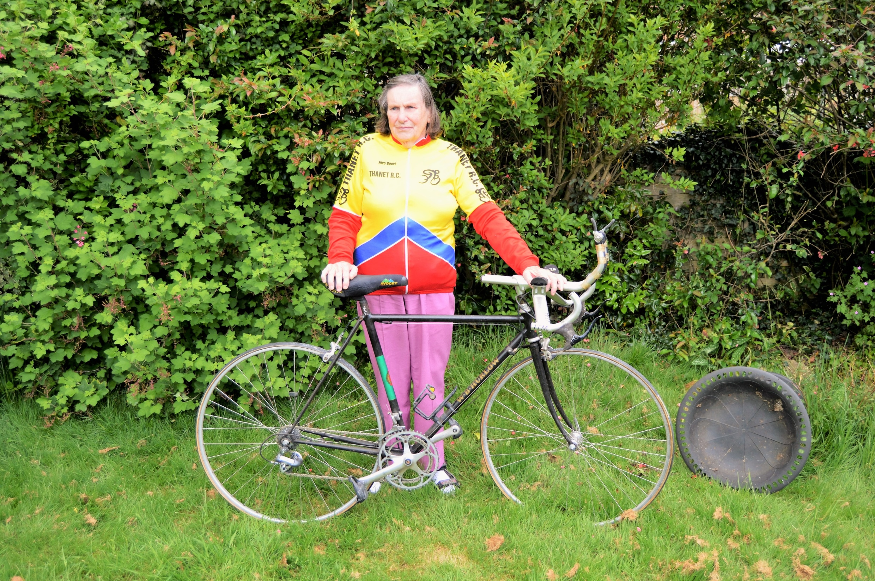

Slide 6
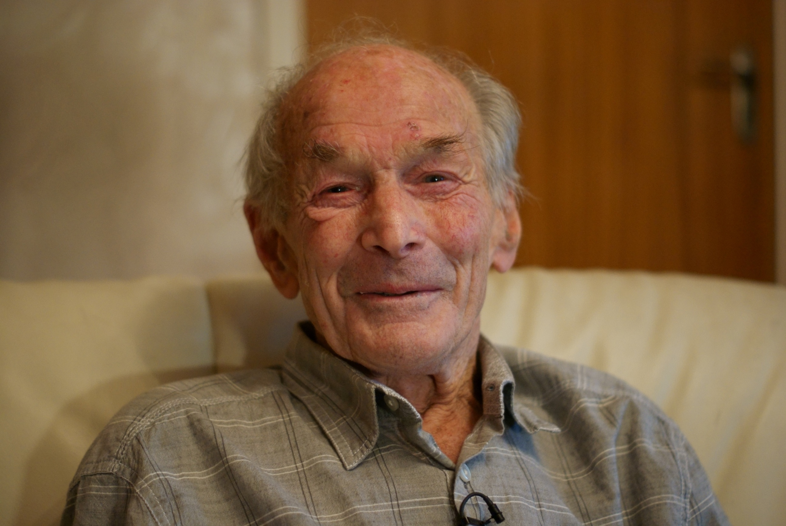

Slide 7
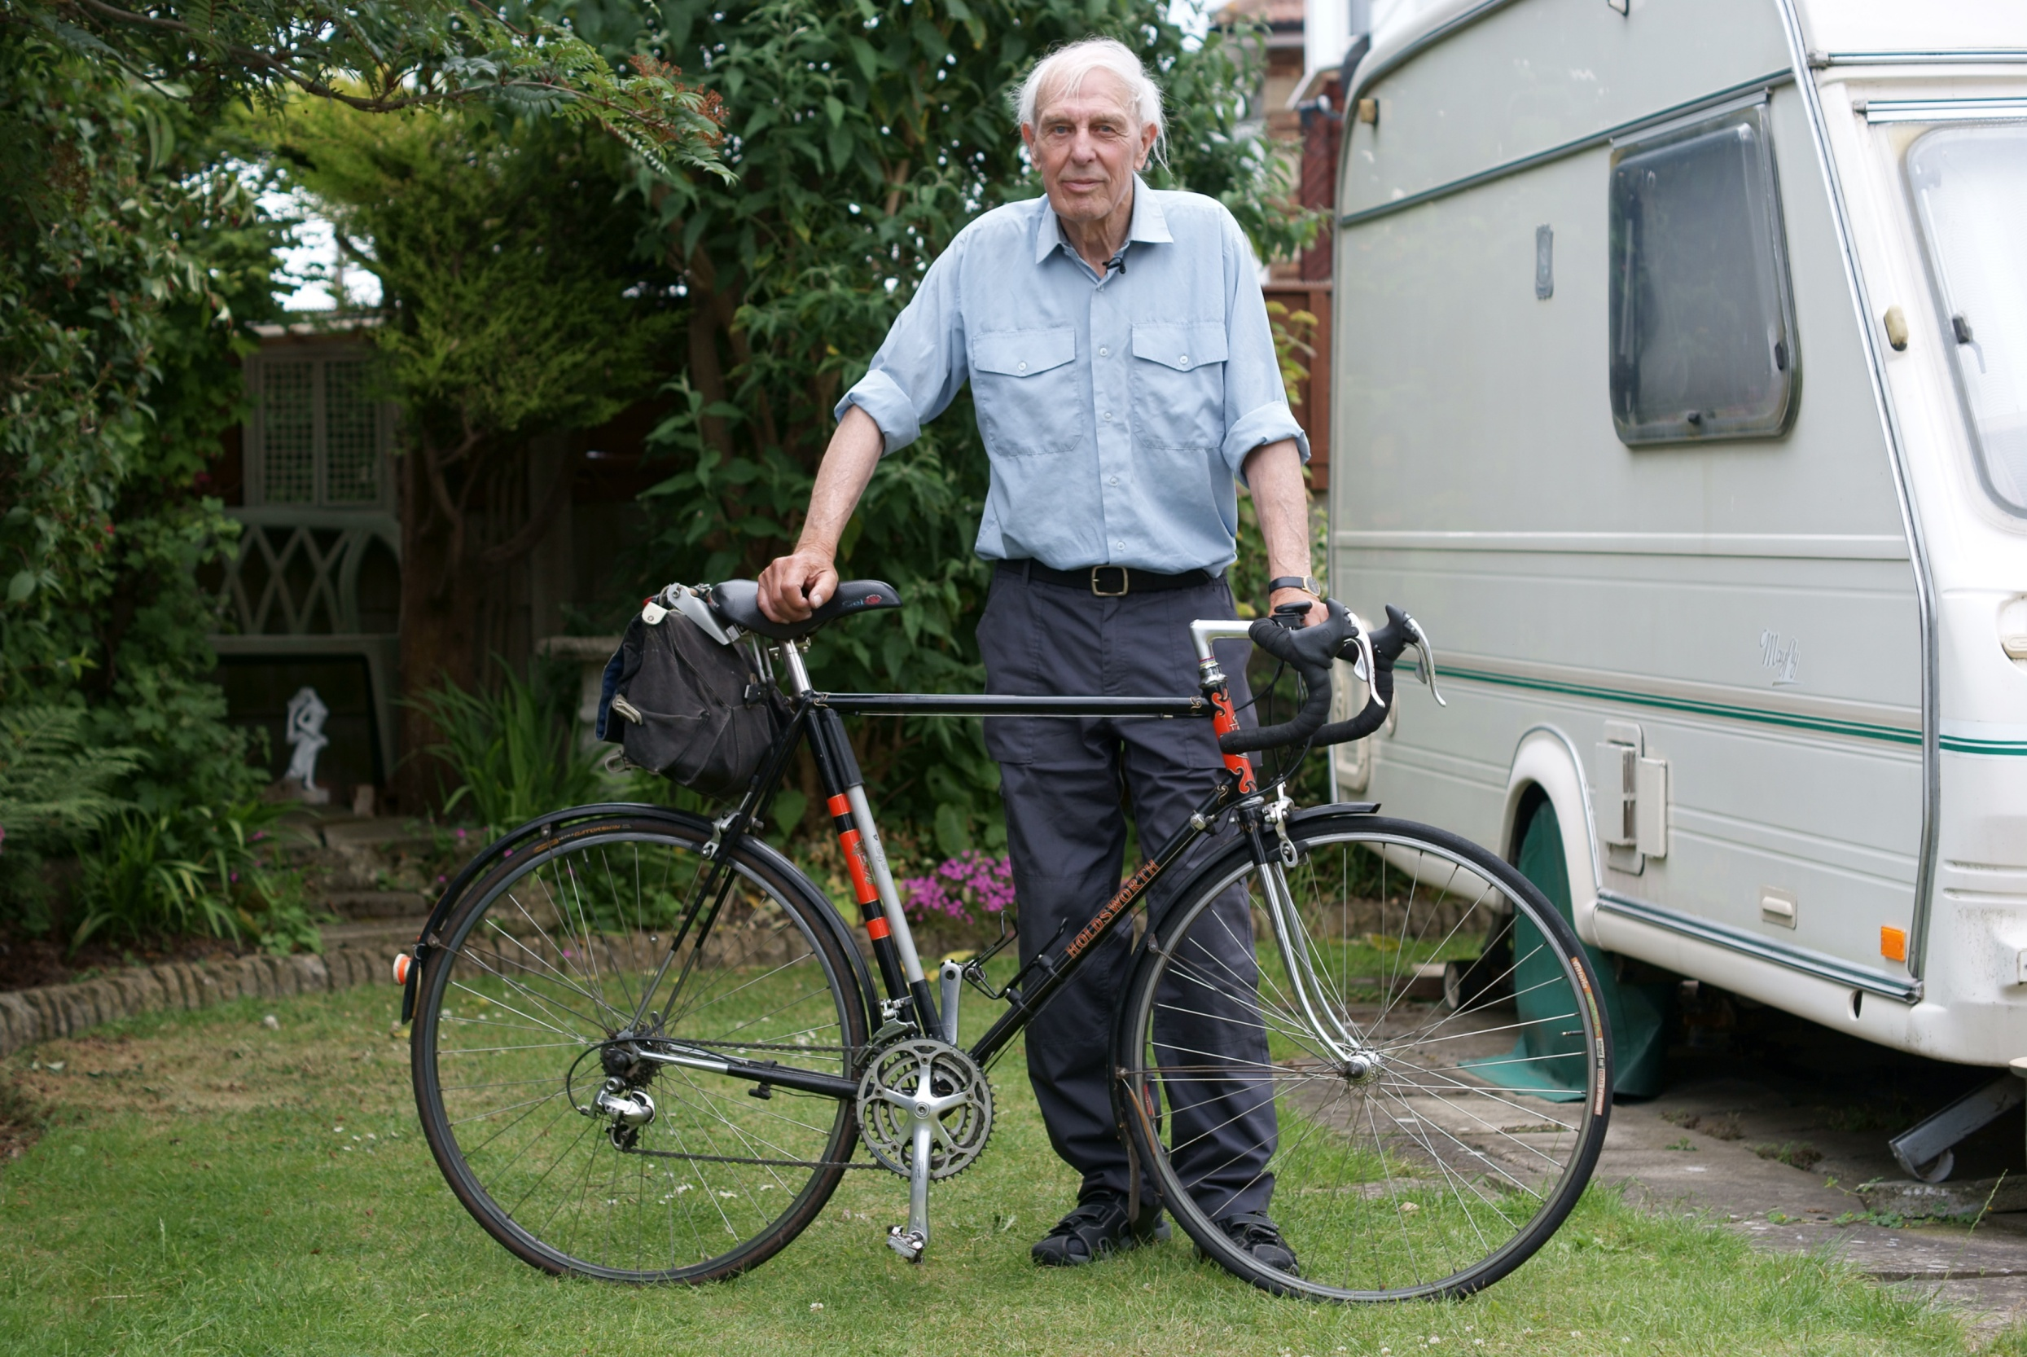

Slide 9
Whites transport £1000- Jnr Race team
WW Martin £500 – Youth Development Squad
Ken Jones Adalta £250 – Women’s Trophies
Route 1 Café Deal- Good Friday 2-Up
Richard Braginton- Easter Monday 2-Up

Slide 10
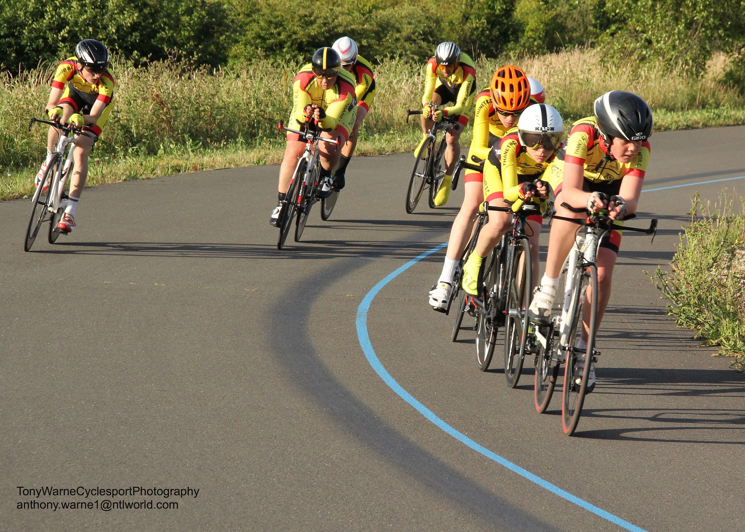
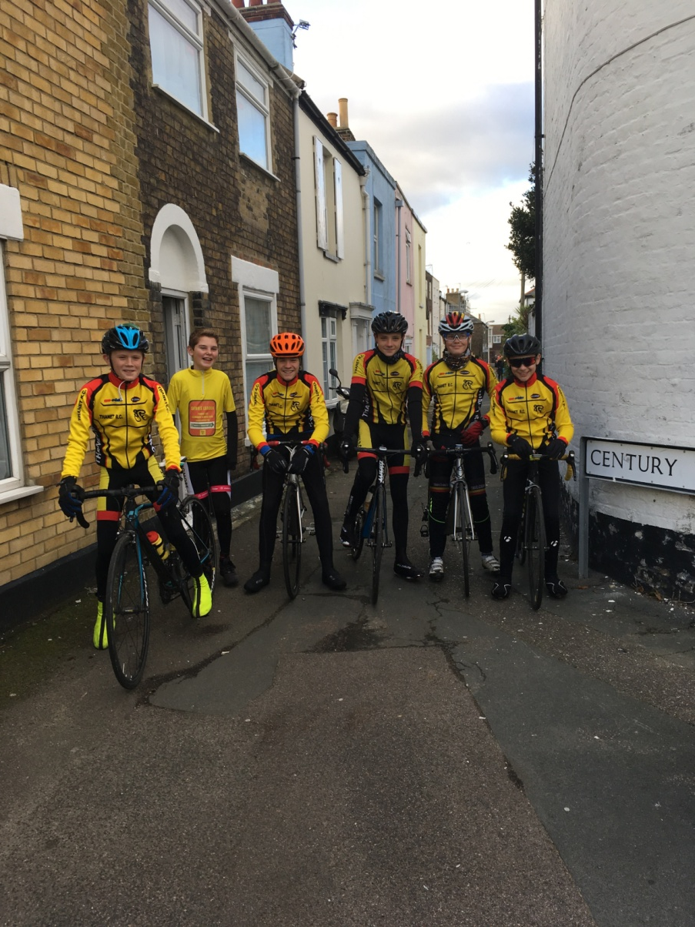

Slide 11
Funding – Situation Vacant (Supported)

Slide 12
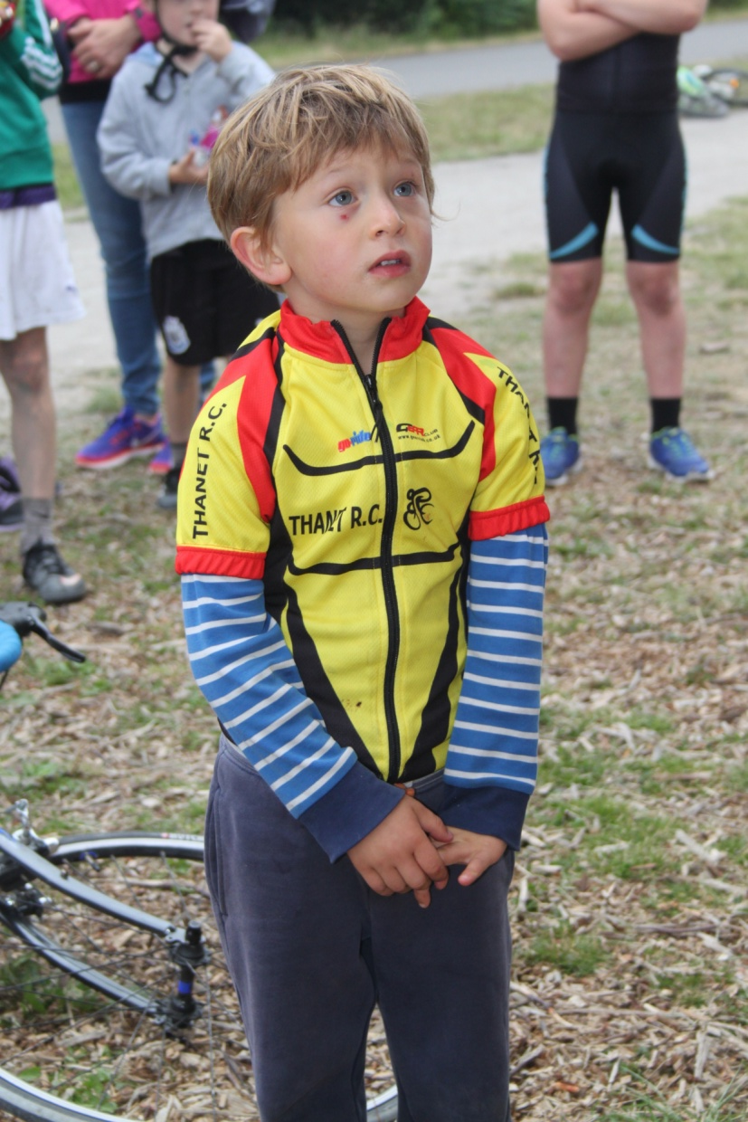
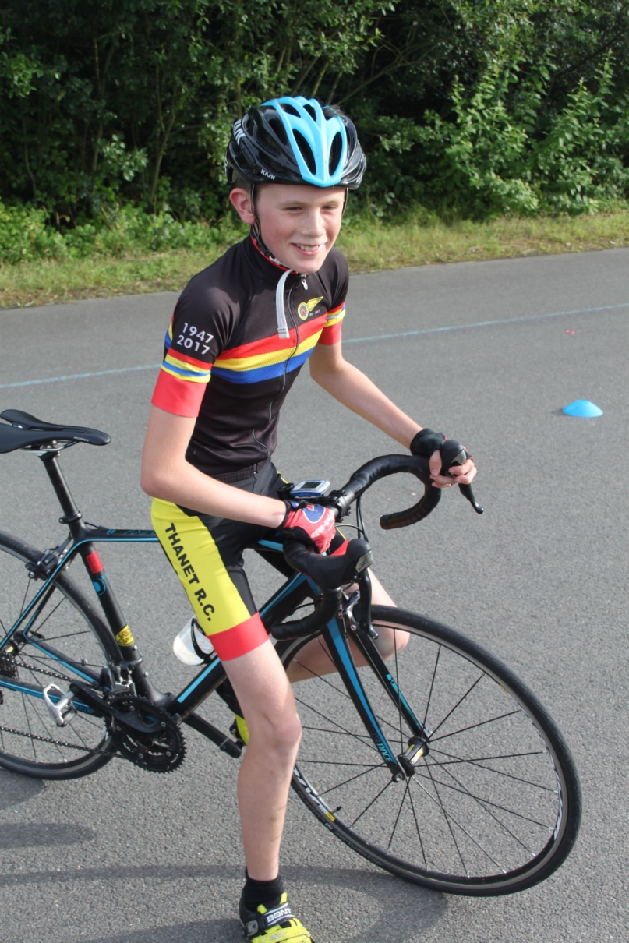
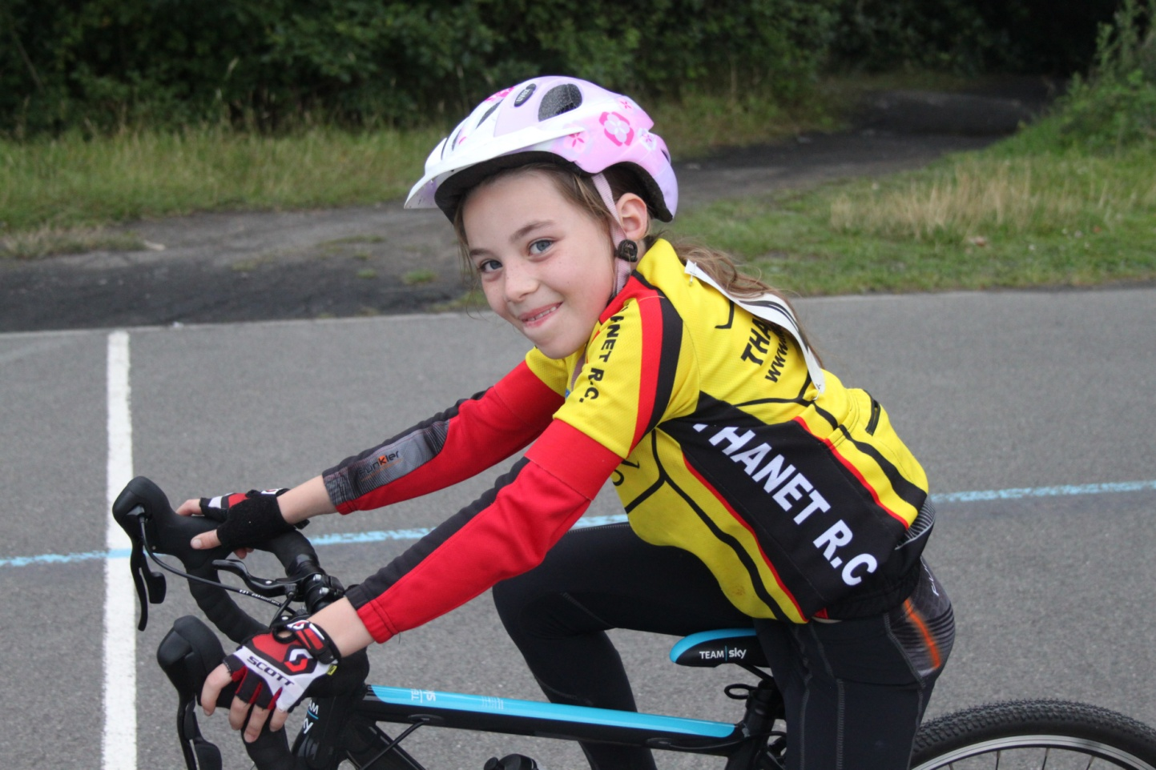
davealexrob@yahoo.com
Any questions?

