Slide 1
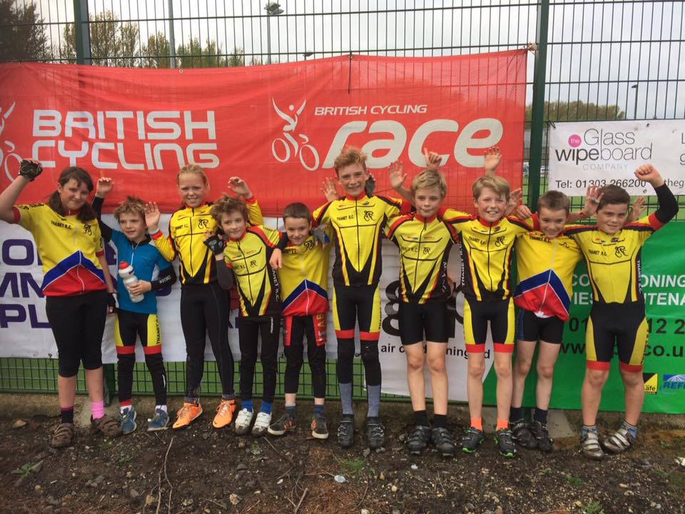
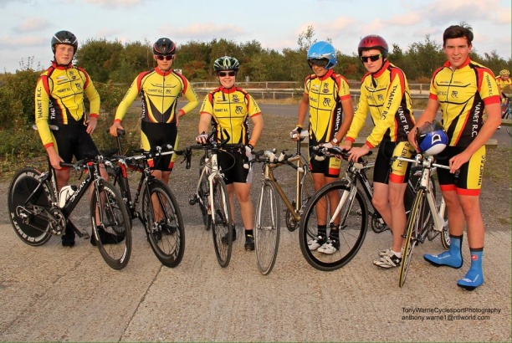
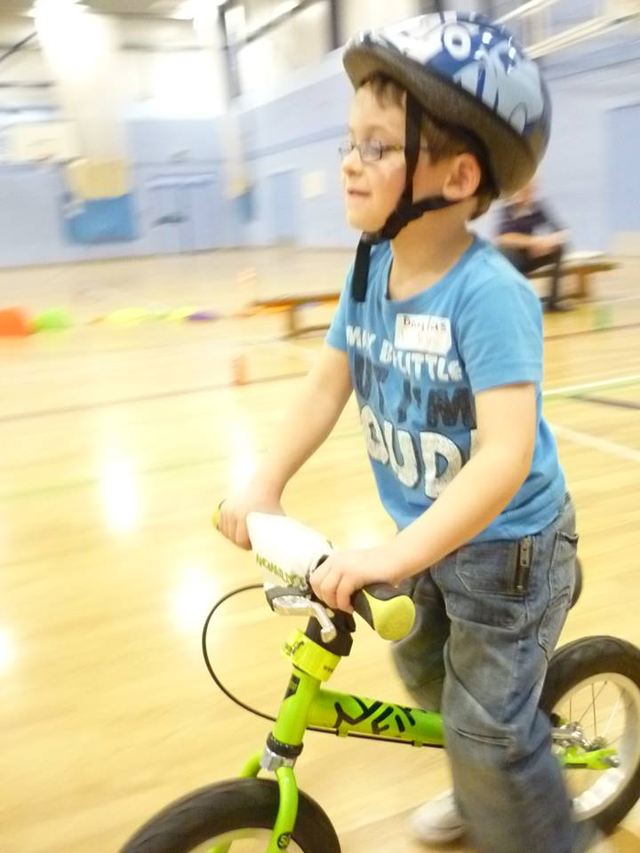
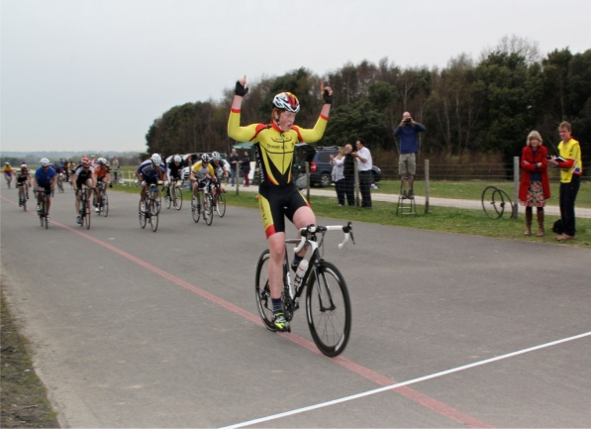
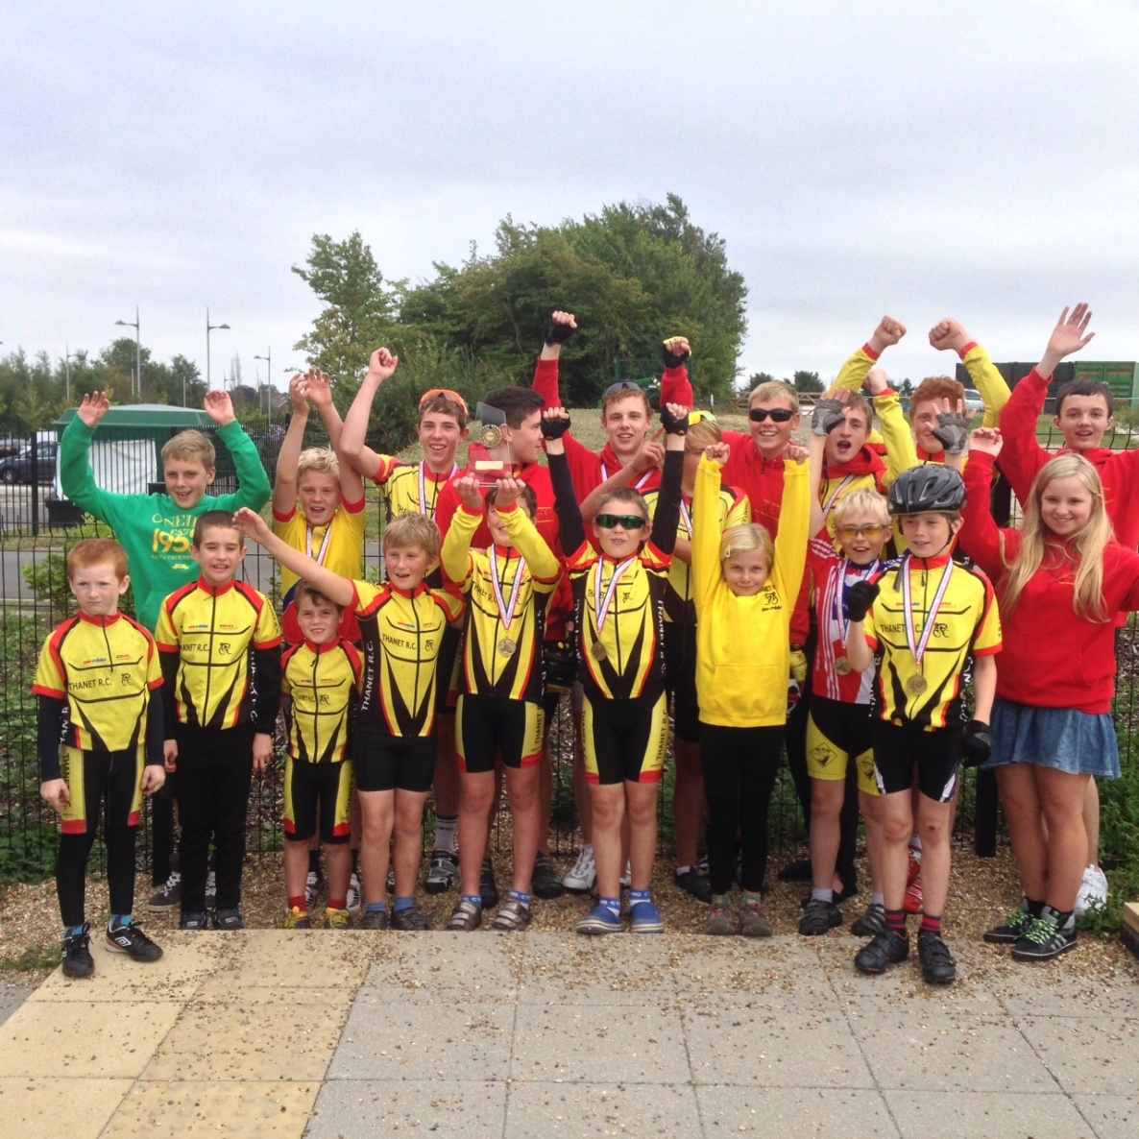
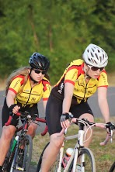
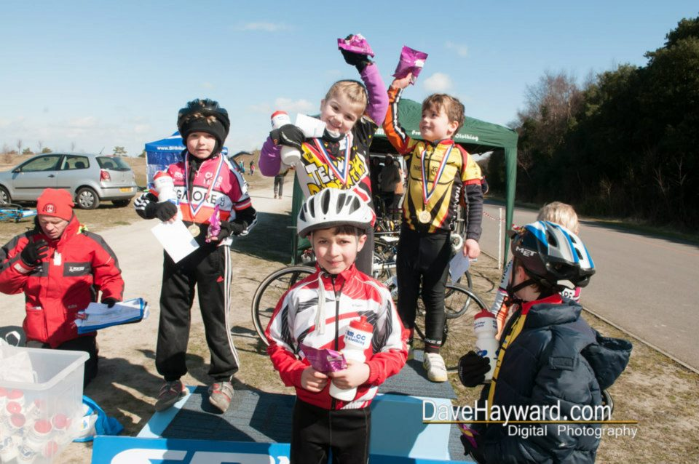
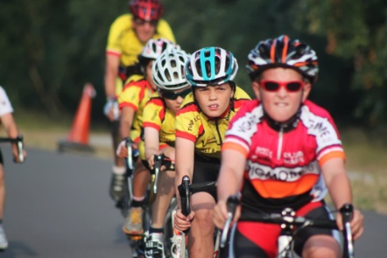
Club of the Year - Thanet Sports Awards 2013 South-East British Cycling club champions 2013 National Go-Ride club of the year runner up 2014 A Club for All (Time trials, MTB, Road, Track, CycloX)
Website www.thanetrc.org Contact: Robinson_colin5@sky.com

Slide 2
Thanet RC “A CLUB FOR ALL”

Slide 3
Go-Ride section (4-16 years) – 30% girls
Ladies novice races
Club membership 4-87 years
Family membership increasing
Race team as aspiration to youth to achieve

Slide 4
Thanet RC youth membership

Slide 5
Thanet RC BC National Points 2016
Rank | Rider | Points
1 | George Pittock | 37
2 | Alexander Ashman | 14
3 | Hamish Reilly | 9
4 | Joshua Chivilo | 6
5 | Toby Perry | 6
6 | Lance Childs | 5
7 | Flynn Robinson | 4
Total |  | 81
Rank | Rider | Points
1 | Oliver Robinson | 121
2 | Rob Milnes | 40
3 | Alastair Clifford | 2
4 | Toby Hammond | 1
Total |  | 164

Slide 6
SOCIAL

Slide 7
Eastbourne weekend (4 riders under 12!)
Paris-Roubaix watching (April)
Summer BBQ
Monthly social meeting in St Nicholas at Wade
Ghent 6 trip
Indoor Wattbike championship night (Jan 2016)
Suggestions for 2017 – 70th year?????

Slide 8
VARIETY

Slide 9
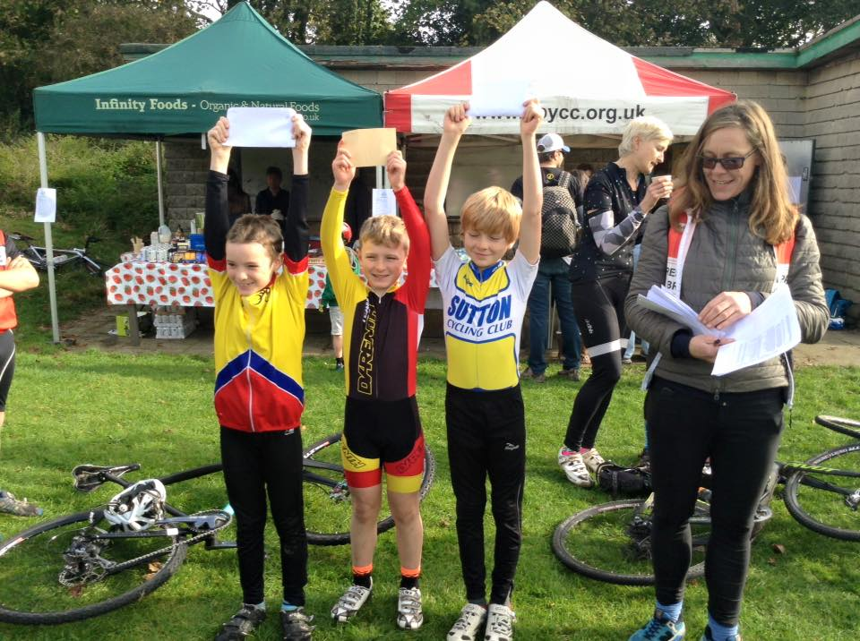
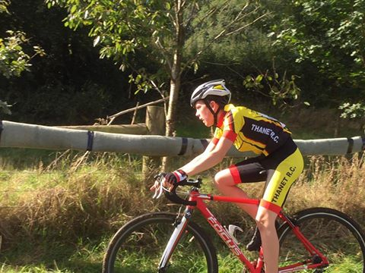
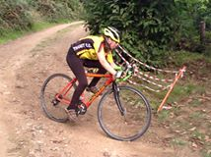
Cyclo X
Ludhaigh Cook many top 3 finishes in U10 (London and EKCX League)
Freya Cook many podium finishes in U12 girls events at London and EKCX leagues)
Successful Halloween TRC cyclo X racing
Toby Perry podiums in juniors (London and EKCX League)
Hamish O’Reilly and Jack Hill podium places in U14/16 (London and EKCX League)

Slide 10
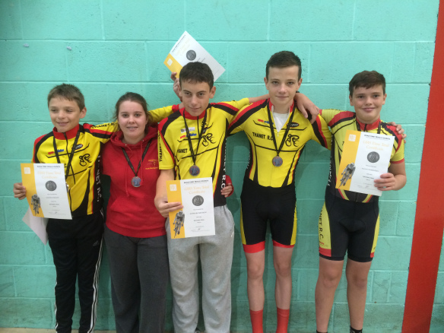
Time Trial
New records 2016
Oliver Robinson Junior 10 mile TT record 21:14
Age Records (10 miles)
12 year-Boy Flynn Robinson – 25:46
13 year-Boy Lance Childs – 24:12
17/18 year-Boy Oliver Robinson – 21:14
Age Records (25 miles)
12 year-Boy -Lance Childs– 1:11:04
13/14 year-Boy – George Pittock -1:08:49
17 year-Boy - Dan Martin– 55:57
Age Records (25 miles)
10/11/12/13/14 year-Girl –Freya Cook– 1:49:19
GHS Final qualifies 2016
Flynn Robinson (12), Lance Childs (13), Charlie Burgess (16), Joshua Chivilo (15),
Toby Hammond (16) and Megan Griffiths (16)
Dan Martin and Ollie Robinson – TT report with RT (ROB) (Junior nationals etc)

Slide 11
Road
Rank | Rider | Points
1 | George Pittock | 37
2 | Alexander Ashman | 14
3 | Hamish Reilly | 9
4 | Joshua Chivilo | 6
5 | Toby Perry | 6
6 | Lance Childs | 5
7 | Flynn Robinson | 4
Total |  | 81
No BC points in 2016 for under 8 / 10 / 12 riders
George Pittock top TRC point scorer with a number of road race wins in 2016
George also raced National Championships in 2016 at Redbridge
New point scoring riders to 2016 Alex, Hamish and Toby
Great season for Joshua Chivilo with summer series win
Max 2nd in Spring in the park series and won summer series
Fearne, Millie and Freya perform well in girls races
Lance and Flynn gain a number of podium finishes

Slide 13
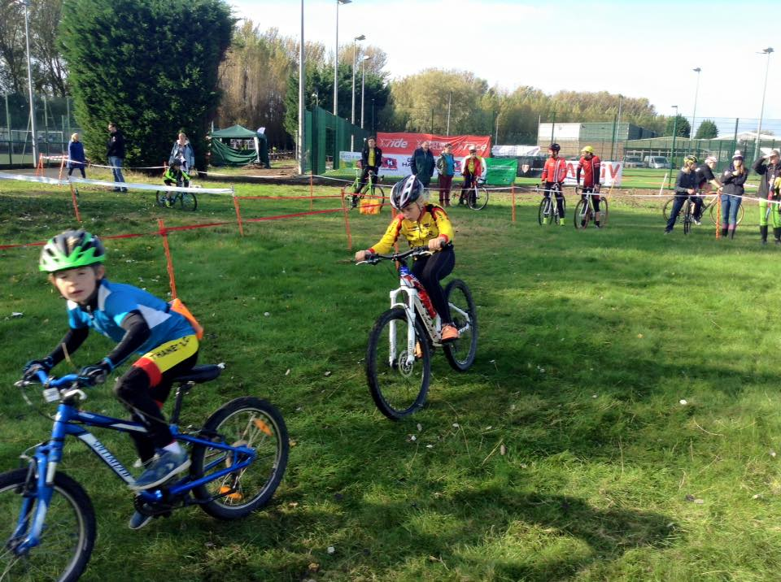
MTB
TRC again run highly successful winter MTB series
TRC riders top podium in all age categories

Slide 14
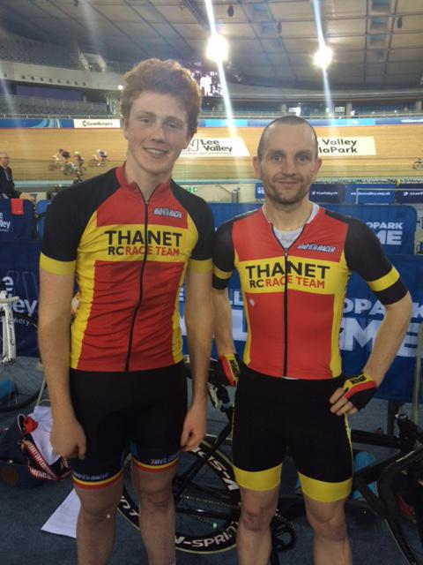
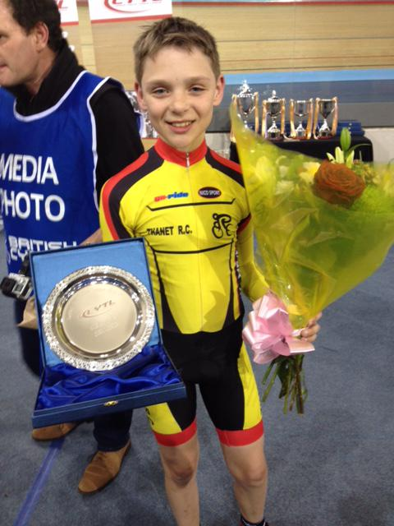
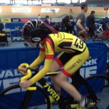
Track
Lance performs very well in London Youth track league 2015-16 (2nd in age group)
Ollie wins Full gas track league Group B (Now racing up in A group)
George and Lance competing in 2015-16 LYTL just started
Lance and George attended many track coaching sessions in 2016
Teresa Childs qualified Level 2 Track coach

Slide 15
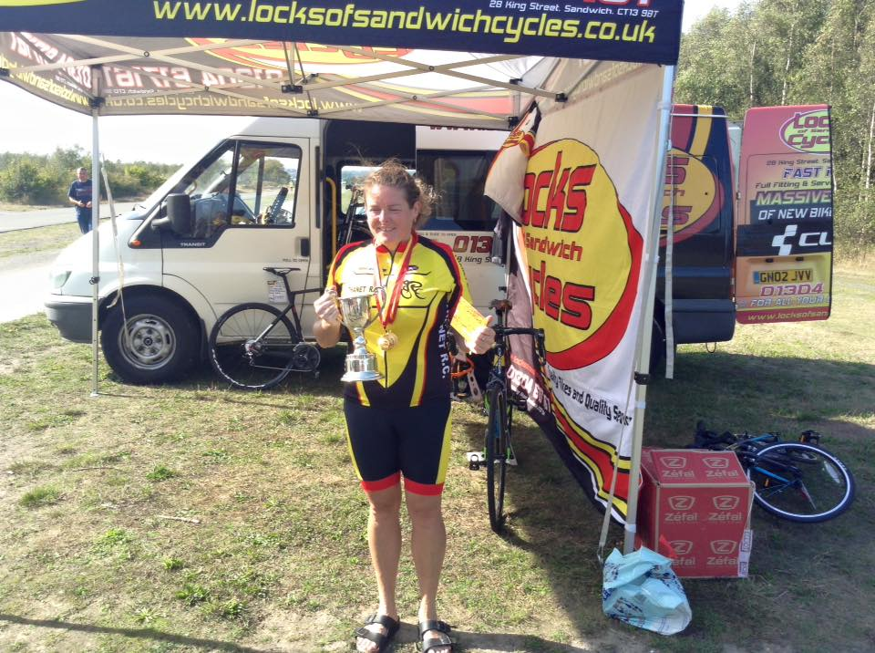
Lock women’s road race league series
Organised by Phil Cook
Thanks to Locks Cycles for sponsorship
Important event to keep girls in the sport

Slide 16
Proposal for further trophies/classifications in junior section (Girls parity with boys)
Along the same lines as Caroline Rigby (women’s rep proposal)
Junior Girls (Under 18) – Hill Climb
Junior Girls (Under 18) – Junior TT Championship
Best average speed for rides from two 25 and two 10 mile rides in the season
Juvenile Girl Championship (Under 16)
Rider with best average speed over 5 rides in 10 mile time trials during the season

Slide 17
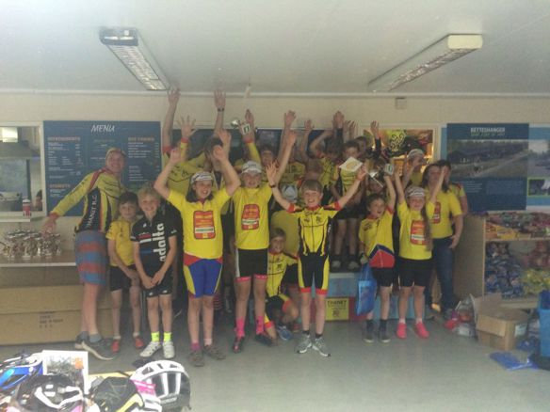
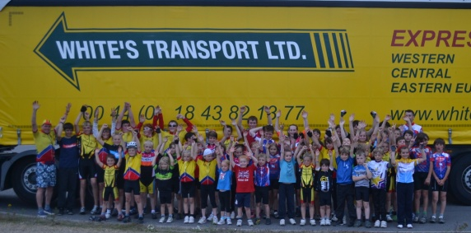
THANET RC Go-Ride racing events 2016
7th Annual Grasstrack event
Six week Summer series (Fowlmead Monday nights – Road)
Four race Winter series (Fowlmead MTB)
Total of 11 GRR events in 2016 (Top number in SE)

Slide 18
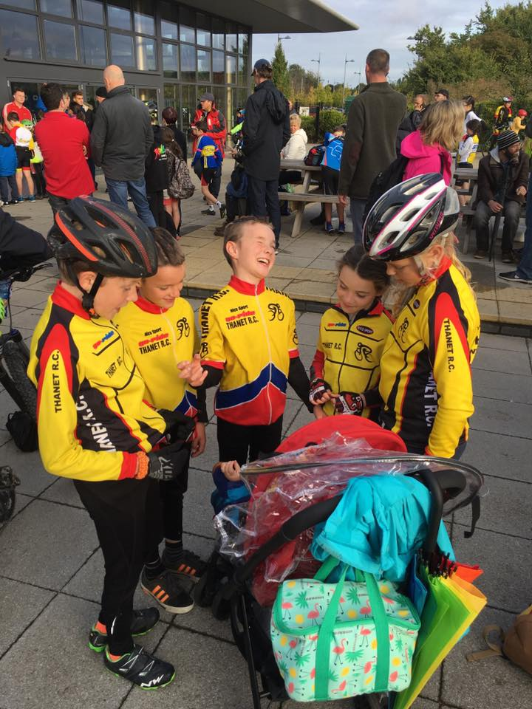
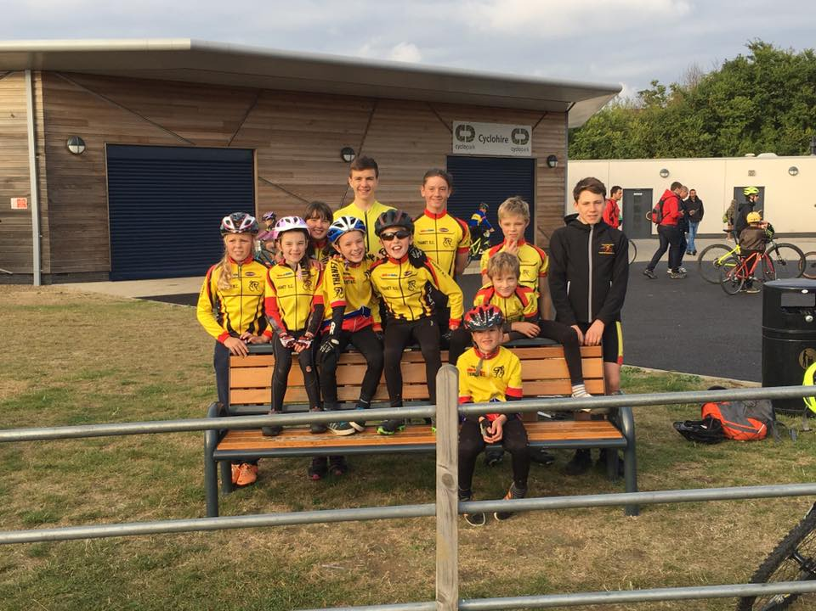
Thanet RC 4th Place in SE Go-Ride Racing championships

Slide 19
THANET RC Youth Regional racing events 2016
Thanet RC / St Peters Bike shop event
3 race Thanet RC – Tour series
Total of 4 Regional Youth events in 2016

Slide 20
Go-Ride 2016 Coaching
Nine Level 2 qualified coaches
Colin Robinson (Level 3 Road/TT)
Richard Bazin
Teresa Childs (Level.2 Track)
Steve Langman
Steve Quincey
Annie Newport (Level.2 Road/TT/MTB and Level.3-MTB)
Jo Smith
Helen Hill
David Robert
Now have Four Level 1 qualified coaches
David Redmond
Dan Martin
Ollie Robinson
Maddie Bazin
ClubMark completed in 2015 (3 more years accredited)
Go Ride Section admin – Colin Robinson taken on from Teresa Childs
Keen for someone else to take on this role

Slide 21
VOLUNTEERS

Slide 22
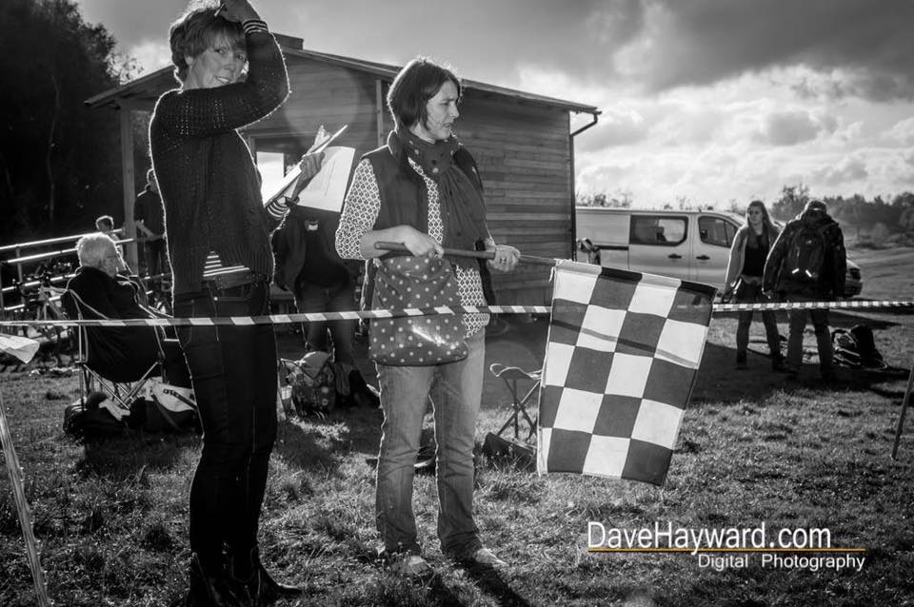

Slide 23
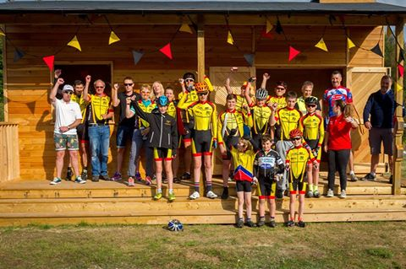
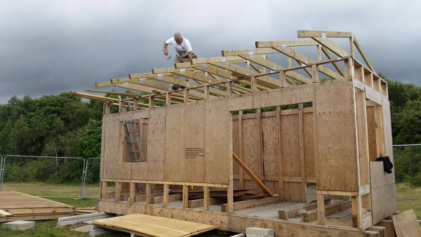
Club ran 56 events in 2016 (More than any club in the south-east)
Approx 250 volunteer places filled by our club members
Huge Thanks to Tony Arnold and other TRC helpers for construction of Trackside building (Completed Sept 2016)
HUGE THANKS TO
ALL HELPERS IN 2016!!

Slide 24
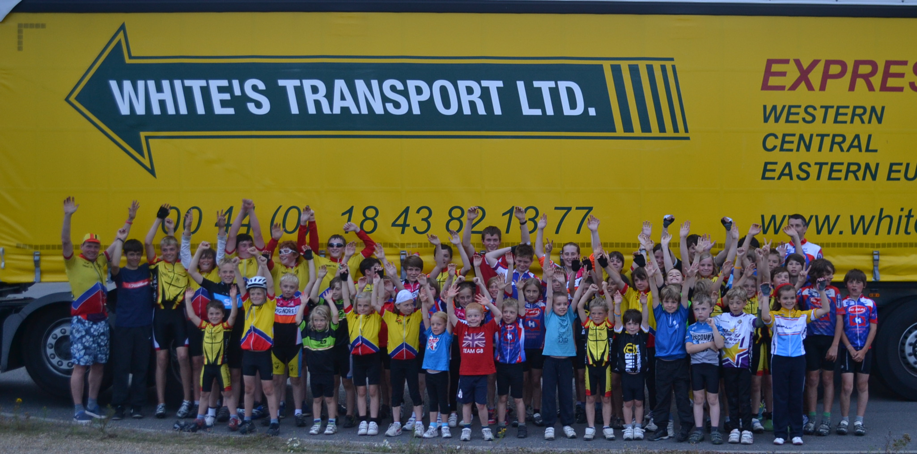
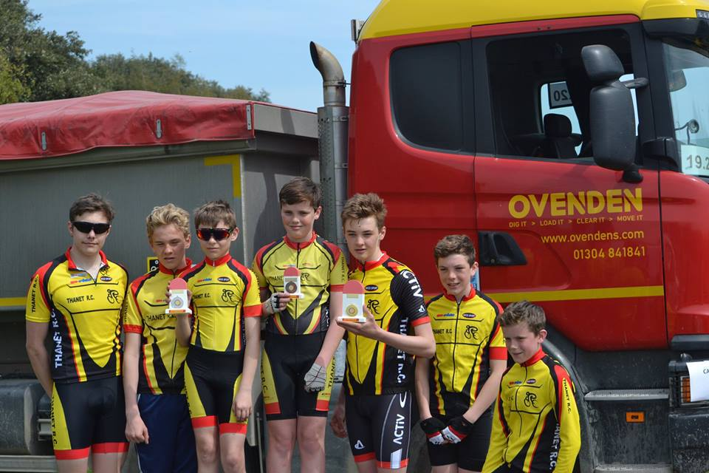
Thanks to all helpers and Sponsors

Slide 25
Betteshanger Update
Building of new visitors centre started winter 2015
No plans to change the cycling facilities
TRC not received track costs for 2017
Good communications links with Betteshanger (bi-monthly meetings)
Campaigning for trackside building (Joint funding from TRC, VC Deal, Deal Tri and Adalta CC) £1.4K per club raised – Thanks to Whites Transport for supplying building shell (SUCCESS!!)
Container for bike/equipment storage in place (Thanks to George Jenkins) (SUCCESS!!)

